Slide 1
Intro to Threading
CS221 – 4/20/09

Slide 2
What we’ll cover today
Finish the DOTS program
Introduction to threads and multi-threading

Slide 3
DOTS
On Friday we had a drawing program
We left with an open question:
How do we allow a user to pick up and drag a dot?

Slide 4
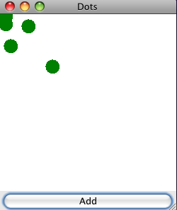
DOTS
We want to add draggable dots to this:

Slide 5
We Already Know
How to get resize, minimize, maximize and close to work
JFrame
How to run code at the click of a button
ActionListener interface
How to draw the dots on the screen
JComponent class
paintComponent() method override
How to capture the mouseDragged event
MouseMotionListener interface
MouseDragged event handler

Slide 6
Problems to Solve
How do we implement two interfaces so we can capture the button click and the mouseDragged event in the same class?
How can we tell if the drag started on a dot?
How do we move a dot with the drag of the mouse?

Slide 7
Implementing Multiple Interfaces
As simple as:
public class MoveComponent extends JComponent implements MouseMotionListener, ActionListener
Implement the missing interface methods
addMouseMotionListener() to the class
Question:
What is the difference between extending a class and implementing an interface?

Slide 8
Did Drag Start on a Dot?
Centers is an arraylist:
private ArrayList<Point> centers;
How can we can test if the mouse drag coordinates match a dot location?

Slide 9
Did Drag Start on a Dot?
Create a new class
E.g. private static class Dots
Expose centers within that class
Getter and setter
Create a method to test if a given point matches a dot
public static Point circleClicked(Point clickedPoint)
Call circleClicked() on a mouseDragged event

Slide 10
How Do We Move the Dot?
centerClicked returned a Point
If we modify that point, what will happen?
Why?

Slide 11
There’s Still a Problem
If we move too fast, we drop the dot.
Why is it happening?
How do we solve this?

Slide 12
Threading
All modern operating systems support concurrency
Concurrency is the ability to do more than one thing at a time
Multiple processes (programs) can run simultaneously
Multiple threads can run in each process simultaneously

Slide 13
What is a Thread?
Short for: “A thread of execution”
A thread is: A single serialized task executed over time
A program can split into two or more simultaneous running threads
All of our programs to-date have contained a single thread of execution

Slide 14
Process vs. Thread
Every process contains at least one thread (1..n)
Threads automatically share memory, address space, and other information inside the process
Processes don’t automatically share memory or address space with other processes
Processes must use special mechanisms to communicate with each other
Threads can easily communicate through shared memory and other resources

Slide 15
How Does an OS Support Concurrency?
Single CPU
Only one thread can physically run at a time
Simulate concurrency:
Interrupting currently executing thread (or process)
Save the state
Choose another thread to execute
Load the saved state for this new thread
Begin execution
Multiple CPU
Can run a thread on each CPU in true concurrency
Will still simulate concurrency in each CPU if there are more threads than CPUs

Slide 16
How Does the OS Choose?
How does it know which thread to run when?
Responsibility of the process scheduler
Usually uses time-division multiplexing based on thread/process priority
High priority threads get more execution time (CPU cycles) than low-priority threads
What kind of data structure do you think the process scheduler uses?

Slide 17
Problems of Caused by Concurrency
What kinds of problems can parallel processes cause?
What kinds of problems can parallel threads cause?

Slide 18
Resource Contention
Process level resource contention:
Files on the file system
Registry entries
Database records
Network resources
Thread level resource contention
All of the above
Values in memory

Slide 19
Race Conditions
Share a data structure between two threads
Data structure takes more than one CPU instruction to update
Two threads attempt to update at the same time
Hilarity ensues…

Slide 20
Race Conditions
Race Conditions result in:
Corrupt data
Application exceptions and crashes
Strange and unexpected behavior
Race conditions are among the most painful and time consuming of all debugging problems.
Something you would only wish on your worst lab partner

Slide 21
Difficulty Testing
Execution is no longer completely deterministic
Application behavior may vary depending on the timing of execution between various threads
Thorough testing is more difficult
Defects may be intermittent
Debugging timing issues can be very tough

Slide 22
How Do You Reduce Problems?
Thread Synchronization!
Remember this term for later, we’ll come back to it…

Slide 23
Multi-threading Benefits
Multi-threading can cause real pain. Why use it?

Slide 24
Multi-threading Benefits
On a single CPU
Increased Performance. Multiple streams of work can be placed in their own threads and priority levels set accordingly.
Increased Responsiveness. Processor intensive tasks can be in a separate ‘worker’ thread. UI thread can still respond to the user.
Simplified Asynchronous Programming. Wait for responses on a separate thread

Slide 25
Multi-threading Benefits
On multiple CPUs, all the previous benefits plus:
Superior Performance. If you have multiple threads, they can be run in parallel by multiple CPUs.
Keep in mind:
Your program will always run on a single CPU unless you use multiple threads.

Slide 26
Java Threading
Concurrency support is built into the Java language and the class libraries
Every Java program starts with one thread – the Main thread.
The Main thread can create additional threads
Each Java thread is associated with a Thread class

Slide 27
Thread Class
http://java.sun.com/javase/6/docs/api/java/lang/Thread.html
Two ways to create a new thread:
Create a subclass of Thread class
Create a class that implements Runnable interface

Slide 28
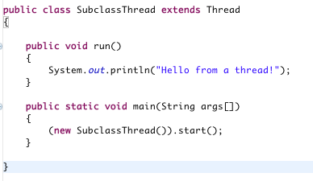
Thread Subclass

Slide 29
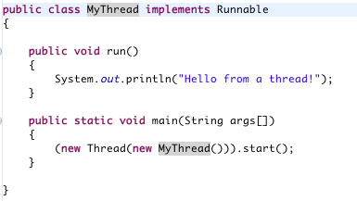
Runnable

Slide 30
Which Should You Use?
They seem pretty similar, when to use each?
Subclass of thread is simple, but not as flexible.
In general, you should implement the Runnable interface as it gives you more flexibility
Can you tell me why Runnable is more flexible?

Slide 31
Thread Class
Thread class has many useful methods on it. For example:
Sleep. Pause execution for a period of time
Interrupt. Stop execution
Join. Wait for another thread to complete

Slide 32
SimpleThreads Program
Start a worker thread from the Main thread
Worker thread prints messages for a period of time
If it takes too long the Main thread will interrupt it

Slide 33
